Slide 1

SWS3009
Lecture 1
Deep Learning I
colintan@nus.edu.sg

Slide 2
Motivation
In the Trial Lecture we looked at neural networks:
Unsupervised and supervised techniques.
Selection of hyperparameters.
Overfitting.
The neural networks of the previous lecture have an issue:
The uniform, fully connected layers mean that there are many many parameters to train.
Compounded by complex data requiring more complex layers.
“Curse of dimensionality” means that we need exponentially more data to train these parameters – and data is hard to get.
We have a tough tradeoff between the learning ability of the neural network, and overfitting.

Slide 3
Motivation
Deep learning neural networks are designed to address these constraints:
Consist of many layers, hence “deep”.
Layers may not be uniform, and can have different functions. E.g. act as filters, feature extractors, etc.
These transform and simplify the data so that less dense networks can be used to learn them.

Slide 4
Motivation
Architectures we will look at in this lecture:
Long-Short Term Memory (LSTMs)
Transformer Models
Autoencoders (AEs)
Architectures we will look at in Lecture 2:
Generative Adversarial Networks (GANs)
Convolutional Neural Networks (CNNs)
Object Detection Networks (YOLO)

Slide 5
Long-Short-term memories (lstm)
SWS3009 Embedded Systems and Deep Learning.

Slide 6
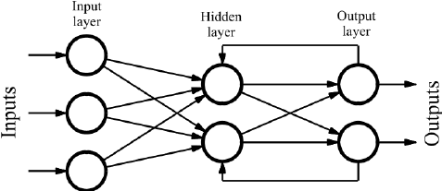
Deep Learning Recurrent Neural Networks
Key issue with MLPs:
When we present training data we assume that all the samples are independent.
This is often WRONG:
E.g. the word “often” above usually follows “is” or “are”. Likewise “is” or “are” often follows “this”. THEY ARE NOT INDEPENDENT!
Solution:
Use past (and sometimes future) information to learn with current data.
In RNNs we feed the output of the MLP back to the hidden layer (and maybe backwards to previous hidden layers)

Slide 7
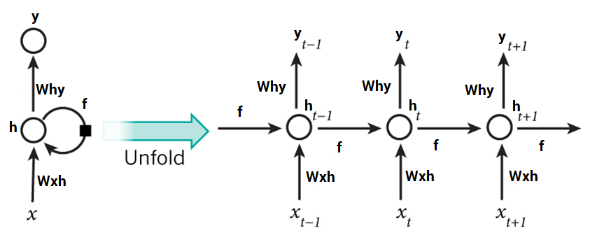
Deep Learning Recurrent Neural Networks
One popular technique to train recurrent neural networks is “backpropagation through time” or BPTT.
Unroll the neural network in time for X time-steps to form a deep network:
Apply standard backpropagation
We see that learning each new piece of data is now affected by past pieces.

Slide 8
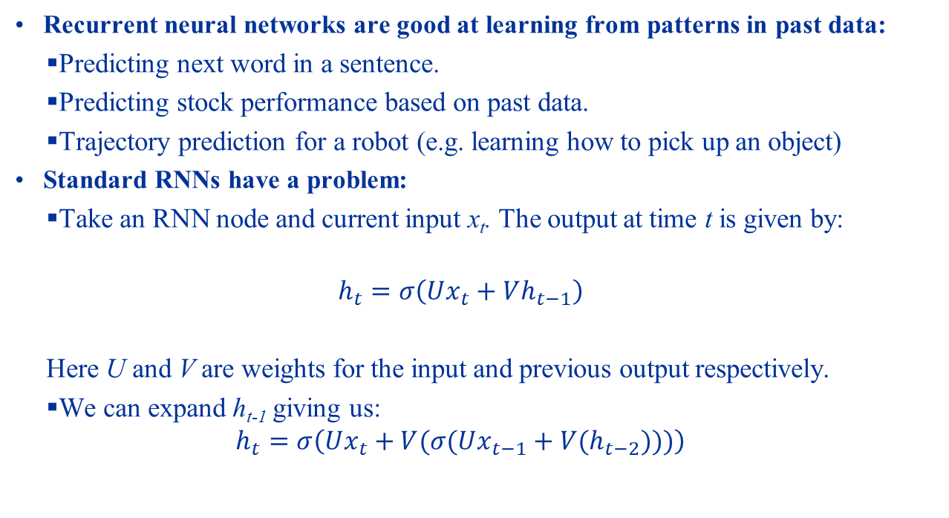
Deep Learning Recurrent Neural Networks
Recurrent neural networks are good at learning from patterns in past data:
Predicting next word in a sentence.
Predicting stock performance based on past data.
Trajectory prediction for a robot (e.g. learning how to pick up an object)
Standard RNNs have a problem:
Take an RNN node and current input x_{t}. The output at time t is given by:
$$h_{t}=σ\left(Ux_{t}+Vh_{t−1}\right)$$
Here U and V are weights for the input and previous output respectively.
We can expand h_{t-1} giving us:
$$h_{t}=σ\left(Ux_{t}+V{(σ(Ux_{t−1}+V(h}_{t−2})))\right)$$

Slide 9
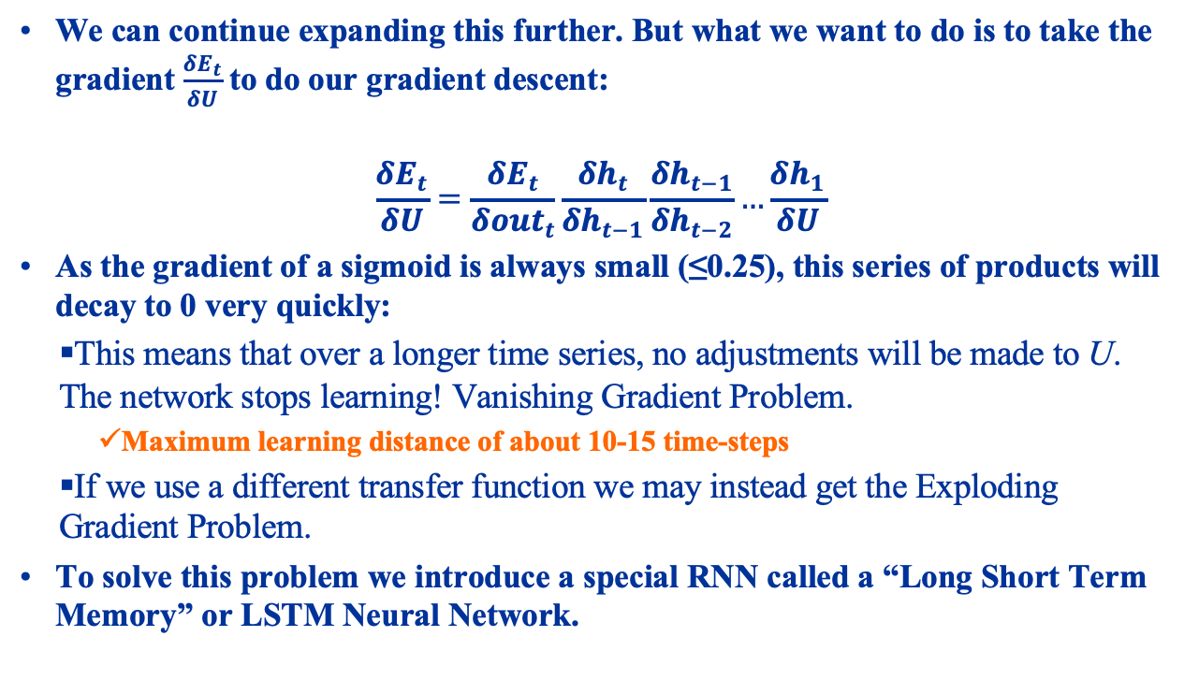
Deep Learning Recurrent Neural Networks
We can continue expanding this further. But what we want to do is to take the gradient $\frac{δE_{t}}{δU}$to do our gradient descent:
$$\frac{δE_{t}}{δU}=\frac{δE_{t}}{δ{out}_{t}}\frac{δh_{t}}{δh_{t−1}}\frac{δh_{t−1}}{δh_{t−2}}…\frac{δh_{1}}{δU}$$
As the gradient of a sigmoid is always small (≤0.25), this series of products will decay to 0 very quickly:
This means that over a longer time series, no adjustments will be made to U. The network stops learning! Vanishing Gradient Problem.
Maximum learning distance of about 10-15 time-steps
If we use a different transfer function we may instead get the Exploding Gradient Problem.
To solve this problem we introduce a special RNN called a “Long Short Term Memory” or LSTM Neural Network.

Slide 10
Deep Learning Recurrent Neural Networks
The issue is that the error gradients either become very small – vanishing – or very large – exploding.
Errors either shrink or grow across time steps.
The solution then is to maintain a (near) constant gradient across time-steps so errors neither grow now shrink:
Constant Error Carousel.
This is the basis of Long Short-Term Memory or LSTM.

Slide 11
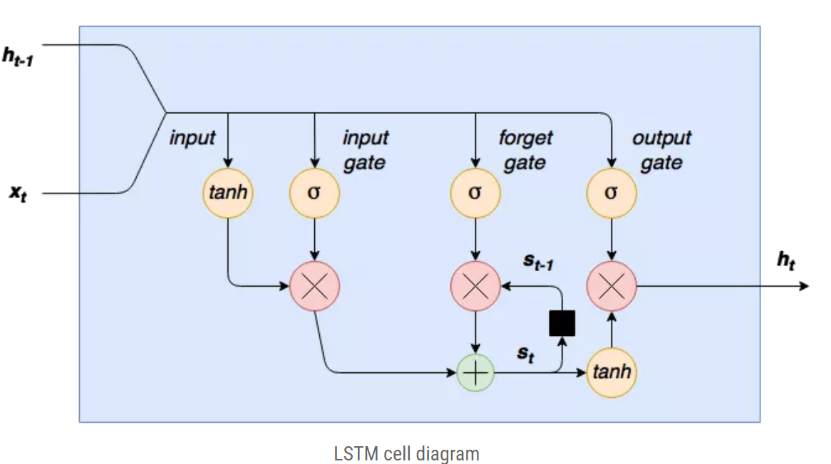
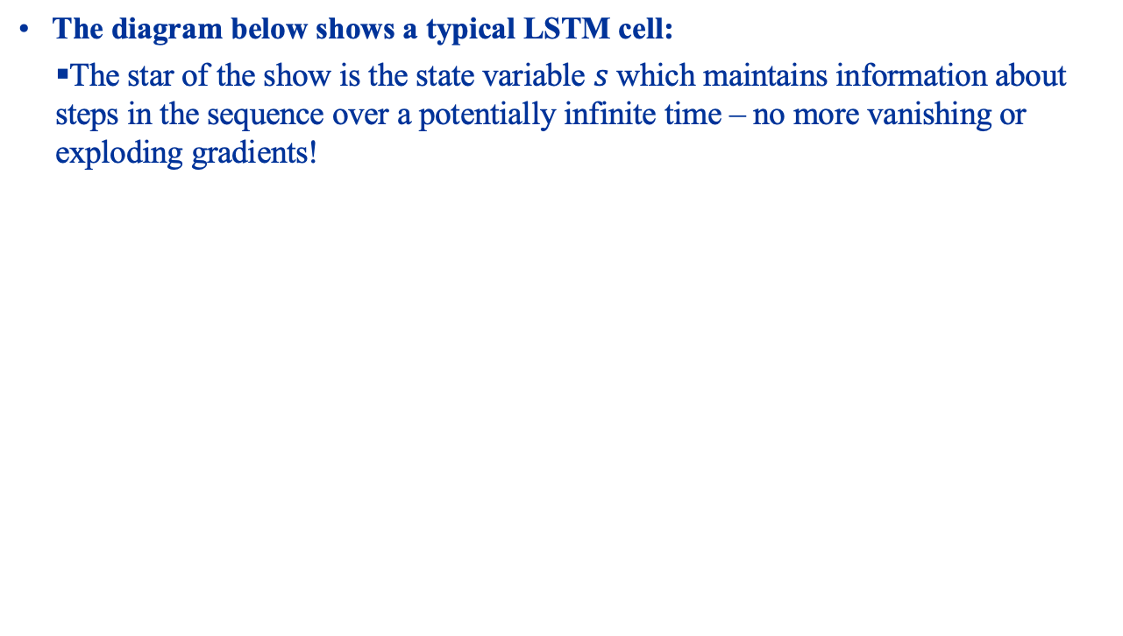
LSTM Cell
The diagram below shows a typical LSTM cell:
The star of the show is the state variable $s$ which maintains information about steps in the sequence over a potentially infinite time – no more vanishing or exploding gradients!

Slide 12
LSTM Cell Input Stage
Learning in the LSTM is controlled through three gates:
Every gate is a neural network that is trained using gradient descent.
The first gate is the input gate:
Controls whether the current input can alter the stored state of the cell.

Slide 13
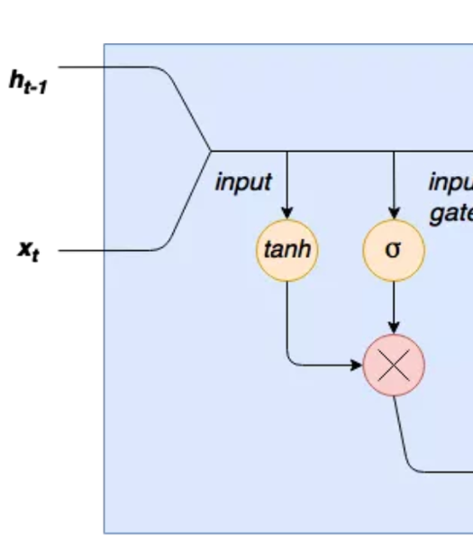
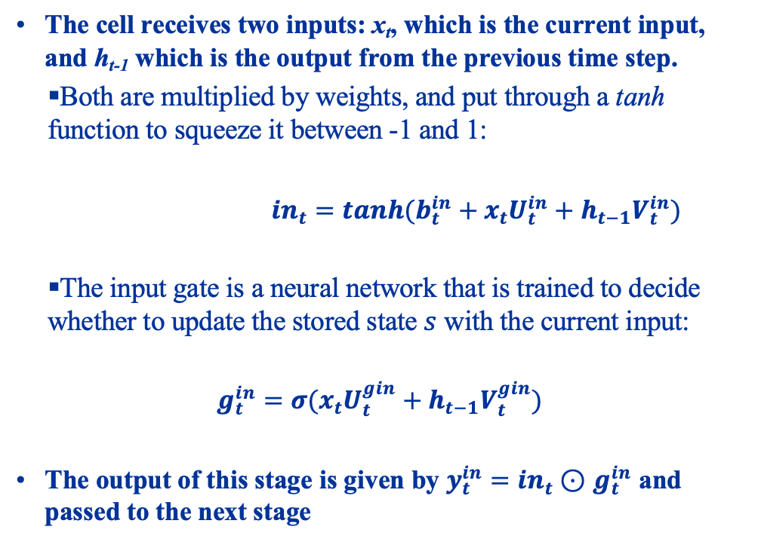
LSTM Cell Input Stage
The cell receives two inputs: x_{t}, which is the current input, and h_{t-1} which is the output from the previous time step.
Both are multiplied by weights, and put through a tanh function to squeeze it between -1 and 1:
${in}_{t}=tanh(b_{t}^{in}+x_{t}U_{t}^{in}+h_{t−1}V_{t}^{in})$
The input gate is a neural network that is trained to decide whether to update the stored state $s$ with the current input:
$$g_{t}^{in}=σ(x_{t}U_{t}^{gin}+h_{t−1}V_{t}^{gin})$$
The output of this stage is given by $y_{t}^{in}={in}_{t}⊙$ $g_{t}^{in}$ and passed to the next stage

Slide 14
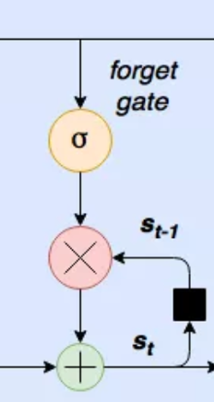
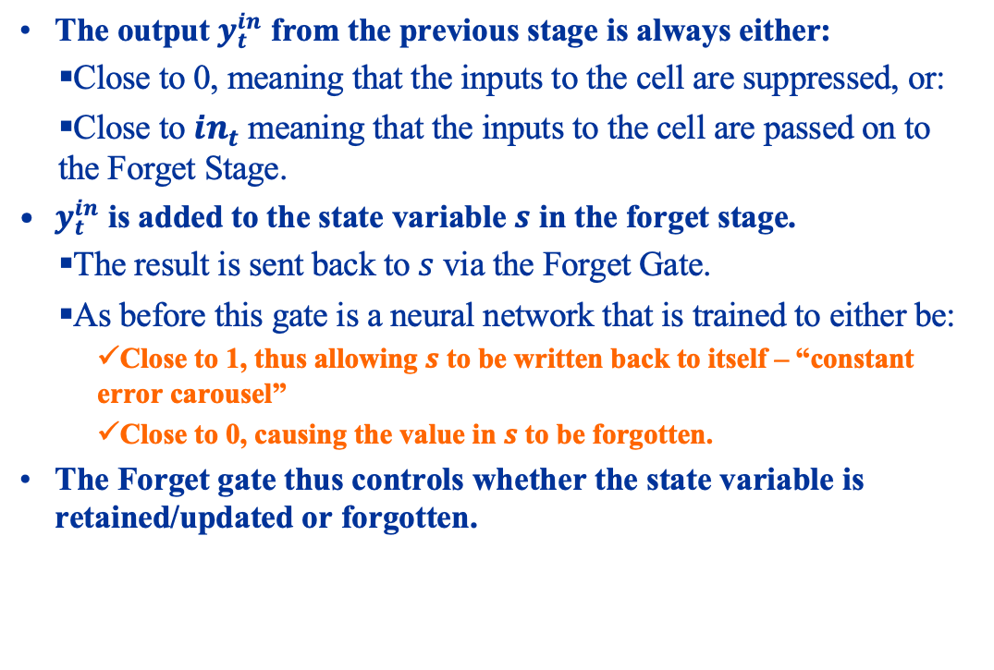
LSTM Cell Forget Gate (Constant Error Carousel)
The output $y_{t}^{in}$ from the previous stage is always either:
Close to 0, meaning that the inputs to the cell are suppressed, or:
Close to ${in}_{t}$ meaning that the inputs to the cell are passed on to the Forget Stage.
$y_{t}^{in}$ is added to the state variable $s$ in the forget stage.
The result is sent back to $s$ via the Forget Gate.
As before this gate is a neural network that is trained to either be:
Close to 1, thus allowing $s$ to be written back to itself – “constant error carousel”
Close to 0, causing the value in $s$ to be forgotten.
The Forget gate thus controls whether the state variable is retained/updated or forgotten.

Slide 15
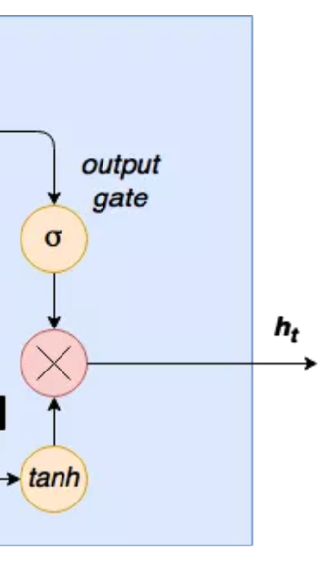
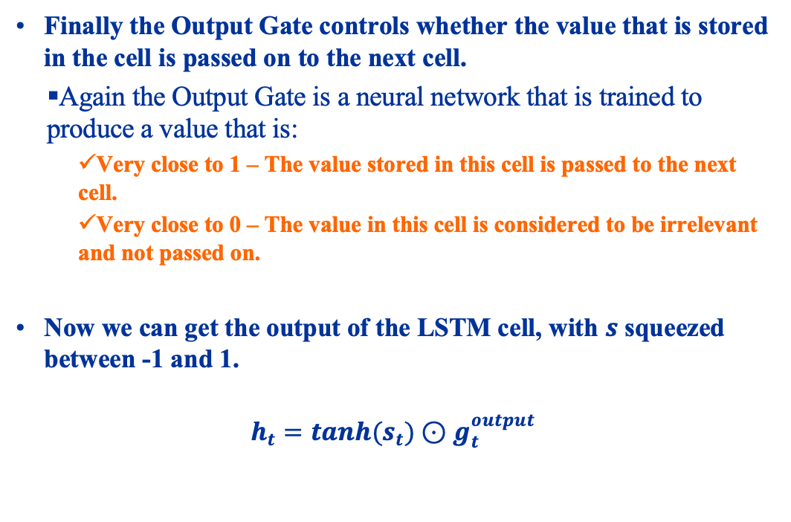
LSTM Cell Output Stage
Finally the Output Gate controls whether the value that is stored in the cell is passed on to the next cell.
Again the Output Gate is a neural network that is trained to produce a value that is:
Very close to 1 – The value stored in this cell is passed to the next cell.
Very close to 0 – The value in this cell is considered to be irrelevant and not passed on.
Now we can get the output of the LSTM cell, with $s$ squeezed between -1 and 1.
$$h_{t}=tanh(s_{t})⊙g_{t}^{output}$$

Slide 16
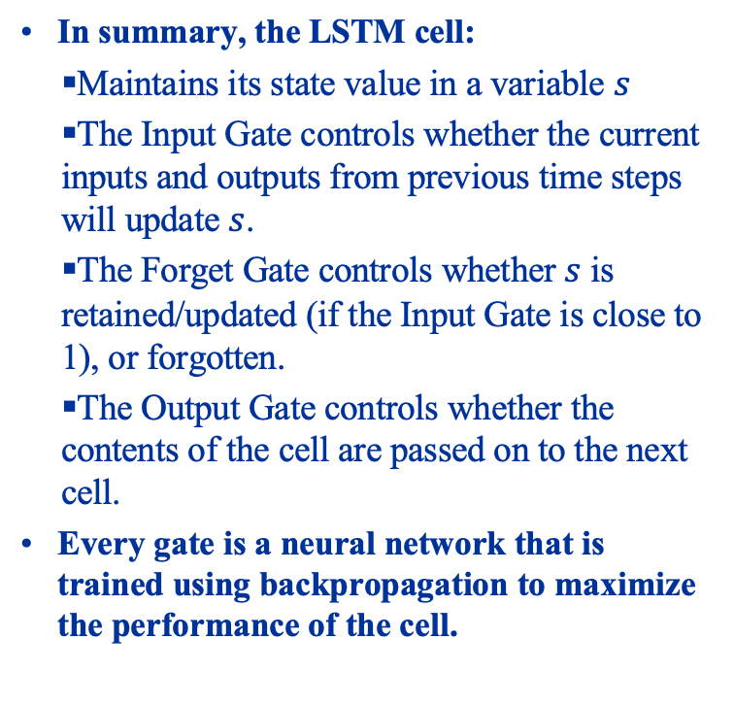
LSTM Cell Summary
In summary, the LSTM cell:
Maintains its state value in a variable $s$
The Input Gate controls whether the current inputs and outputs from previous time steps will update $s$.
The Forget Gate controls whether $s$ is retained/updated (if the Input Gate is close to 1), or forgotten.
The Output Gate controls whether the contents of the cell are passed on to the next cell.
Every gate is a neural network that is trained using backpropagation to maximize the performance of the cell.

Slide 17
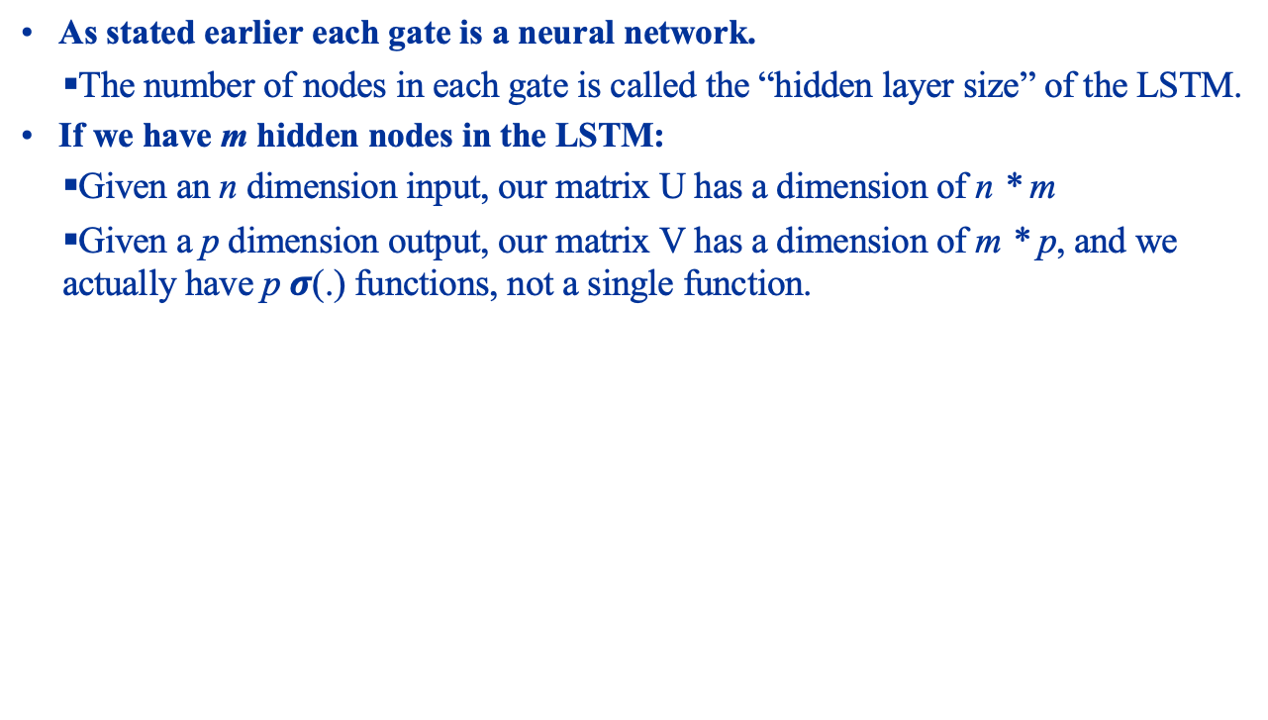
LSTM Hidden Layer Size
As stated earlier each gate is a neural network.
The number of nodes in each gate is called the “hidden layer size” of the LSTM.
If we have m hidden nodes in the LSTM:
Given an n dimension input, our matrix U has a dimension of n * m
Given a p dimension output, our matrix V has a dimension of m * p, and we actually have p $σ$(.) functions, not a single function.

Slide 18
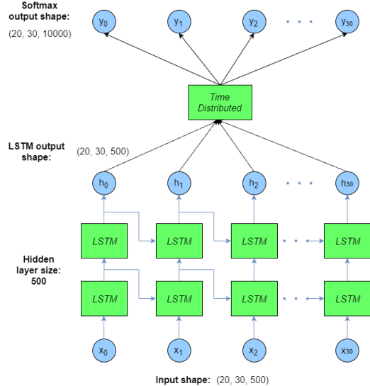
Using the LSTM Cells
The diagram below shows one way we can use an LSTM cell:
Each cell produces one time step, and feeds the next cell, together with the input for that time step.
We can stack LSTMs to increase learning power, and connect Dense layers to learn patterns, etc. from the time-stepped data.

Slide 19
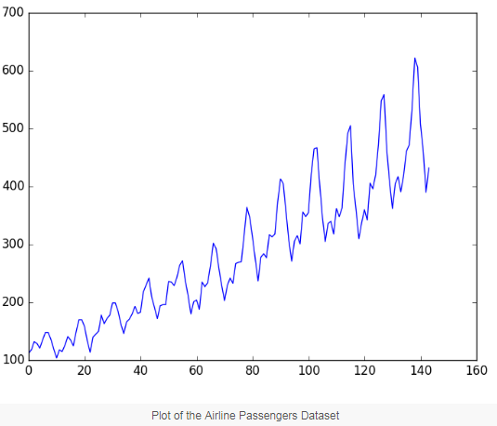
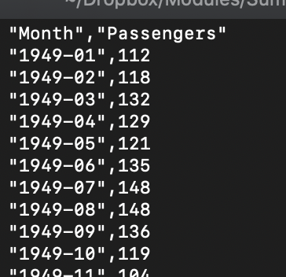
Using LSTMs in Keras
To see how to use LSTMs in Keras, we will use LSTMs to model the growth in airline passenger traffic from January 1949 to December 1960, shown below:
The idea is to learn the data to make predictions about passenger traffic in the next month.

Slide 20
LSTM Hands On
Load up lstm.ipynb in Jupyter

Slide 21
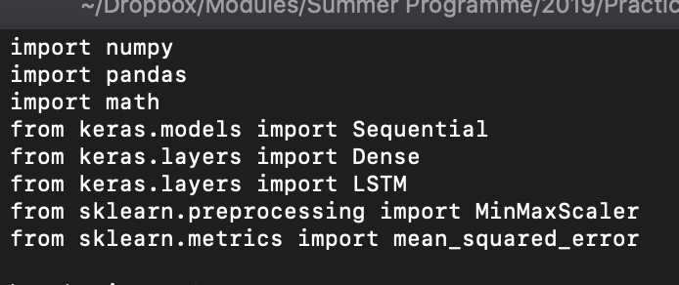
Using LSTMs in Keras Imports
Additional explanation for the Python notebook.
We begin firstly with all the imports:
Here we bring in the LSTM layer for us to build our LSTM network, as well as a Dense layer that we will use to predict growth of airline passenger traffic based on past data.
We also bring in a MinMaxScaler that will scale our data into the [0, 1] range.

Slide 22
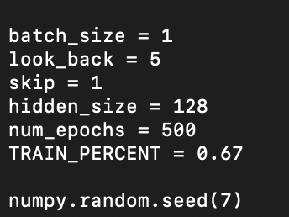
Using LSTMs in Keras Training Hyperparameters
Now we create some constants, and seed the random number generator so that we get reproducible random numbers:
The constants are:
Batch_size = # of pieces of data presented each time for training, look_back = the time span we are learning from (i.e. current time and previous 5 time periods), skip = # of time steps to advance each time, hidden_size = # of neurons in each part of the LSTM. The rest are self-explanatory.

Slide 23
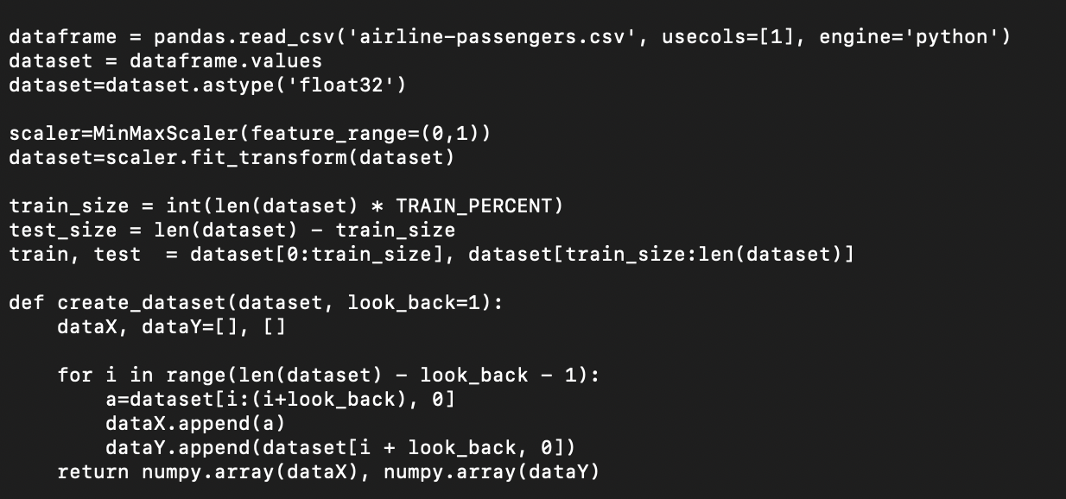
Using LSTMs in Keras Creating the Dataset
We now load the data using Pandas, scale the data to between 0 and 1, then partition the data into training and testing data. We also make a “create_dataset” function.

Slide 24
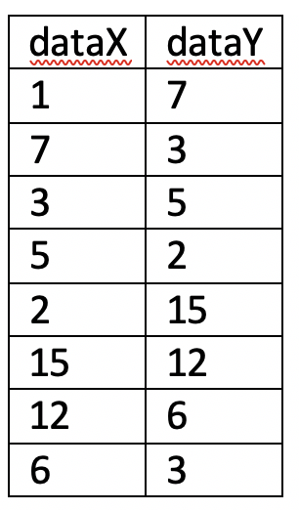
Using LSTMs in Keras Creating the Dataset
The “create_data” function creates a sliding window of data, depending on the value of look_back. If we use a look_back of 1 on the data series “1, 7, 3, 5, 2, 15, 12, 6, 3”, then we get a table like:
So dataY is always one step after the current position in dataX.

Slide 25
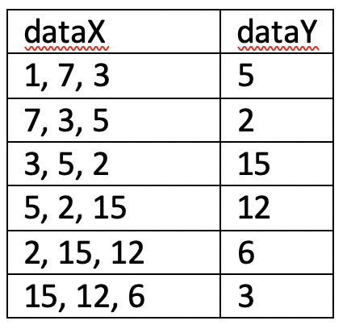
Using LSTMs in Keras Creating the Dataset
If we use a look_back of 3, we get:
Notice that dataX is now a vector of 3 values, while dataY is the next value.

Slide 26
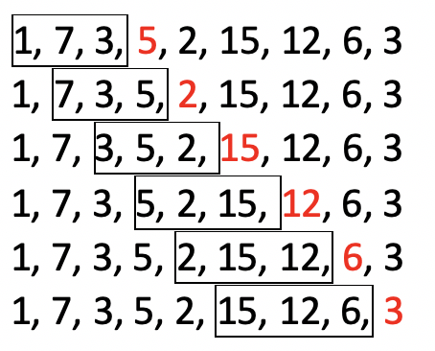
Using LSTMs in Keras Creating the Dataset
The diagram below gives a clearer picture:
The window shows the current X values being considered, while the red values are the next value, which are to be predicted.

Slide 27
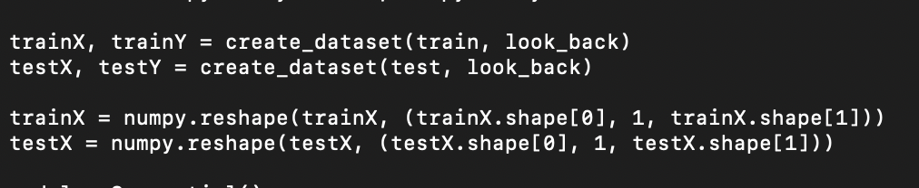
Using LSTMs in Keras Reshaping the Datasets
Since our LSTM is using just a single input (passenger data), our LSTM will have a single input, each input consisting of “look_back” entries. Our training data must be reformatted to match this:

Slide 28
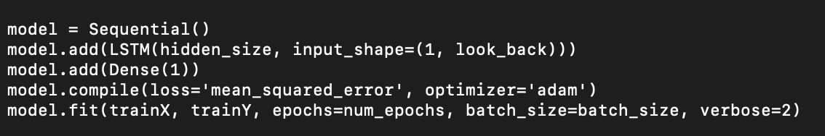
Using LSTMs in Keras Building the LSTM
Now we are finally able to build our LSTM. We will use the LSTM layer in Keras to do this. We also need a dense layer to take the LSTM outputs and produce a single output – our prediction of passenger volumes. Then we add an Adam optimizer and call fit to train the LSTM:
Each gate of the LSTM it itself a neural network, each with “hidden_size” nodes. It expects inputs to be of the shape (1, look_back):
This means it expects a single variable input, each consisting of “look_back” entries.

Slide 29
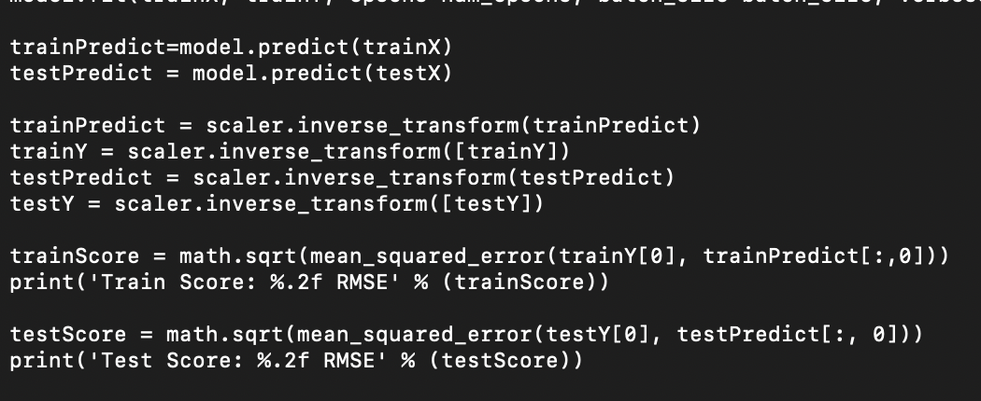
Using LSTMs in Keras Evaluating
Finally we call predict to predict the next value, and use reverse_transform to map back from the [0, 1] range to the range of our original data. We then compare against the training and test data to see the root mean squared error (RMSE):

Slide 30
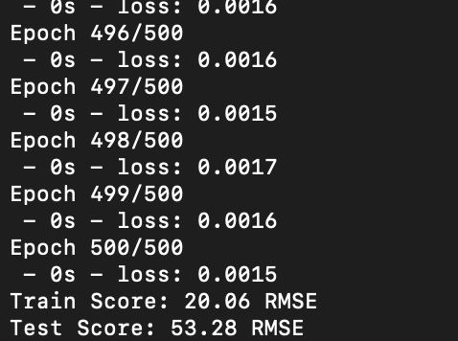
Using LSTMs in Keras Evaluating
When run you will see:

Slide 31
Using LSTMs in Keras Swapping Dimensions
One of LSTM’s strengths is its ability to remember across training batches. We will now see how to do this. Before we start:
It is more intuitive to think of look_back time steps of a single input, rather than single inputs of look_back time steps. So locate these lines:
And change them to:

Slide 32
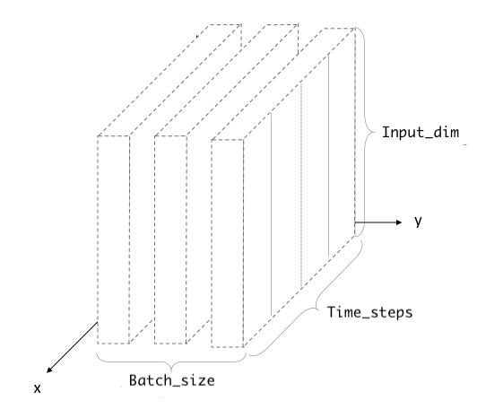
Using LSTMs in Keras Why swap dimensions?
LSTM expects the third dimension to be the input features, NOT the look back.
In our original code we had swapped this around so that the third dimension was the look back, and the second dimension was the input features.
We swapped this back the right way in our second version of the code.

Slide 33
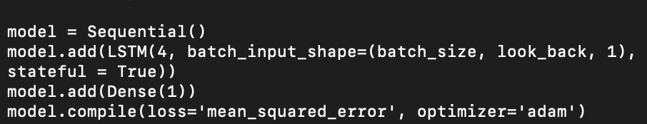
Using LSTMs in Keras Using Memory
To use memory we need to organize the data into batches, and to turn on the ‘stateful’ flag in LSTM. So change:
To:
Note that we have also flipped the input from 1, look_back to look_back, 1, and reduced the number of hidden nodes in the LSTM.

Slide 34
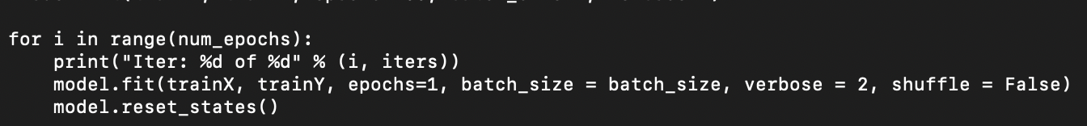
Using LSTMs in Keras Using Memory
We also need to change the model.fit call to run one epoch at the time, because we need to call reset_states(), so that the LSTM knows it is getting a fresh batch of inputs.
Otherwise the LSTM will wrongly tie the end of the previous epoch with the start of the next epoch.
Change:
To:
Note that you MUST turn off shuffling, as we need to present the data sequentially as they occur for the LSTM to learn across them properly.

Slide 35
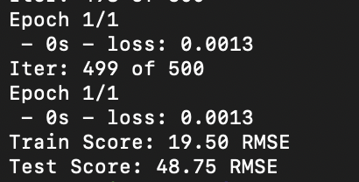
Using LSTMs in Keras Using Memory
When we run our new lstm1.py program, we see:
We see that the results have improved from 20.06 RMSE and 53.28 RSME for inside and outside testing respectively, to 19.50 and 48.75.
In the next lab we will look at how to stack LSTMs to get better results.

Slide 36
transformers
SWS3009 Embedded Systems and Deep Learning.

Slide 37
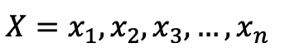
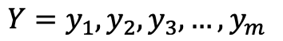
Transformers - Introduction
Materials for this section taken from “Transformers: A Primer”
URL: http://www.columbia.edu/~jsl2239/transformers.html
The Transformer architecture was motivated primarily by the language translation problem:
Given a statement X consisting of a sequence of words in the source language:
Find the equivalent statement Y in the target language:
This has some complications: Notably, words in the source language do not translate directly to words in the target language.
Some phrases may translate to single words and vice-versa.

Slide 38
Transformers - Introduction
One effective way to do machine translation is to have two people who speak a common language C. i.e.
Person 1 speaks languages A and C
Person 2 speaks languages B and C.
Person 1 translates statement X to statement Z into language C.
Person 2 translates statement Z in language C to statement Y in language B.
This is known as an “encoder-decoder” architecture, which most language translation systems use:
The encoder neural network translates from statement X to a vector Z
The decoder neural network translates from vector Z to statement Y

Slide 39
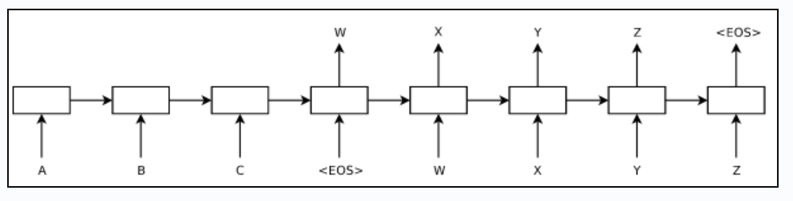
Transformers - Introduction
Earlier efforts made use of RNNs (including LSTMs) to build the encoder and decoder.
Statements were terminated with an end-of-statement symbol <EOS>
A statement X is then encoded to Z, and at the <EOS> symbol, Z is translated to Y.

Slide 40
Transformers - Introduction
To perform translation:
Encoding:
The first word x₁ is fed into the encoder RNN f_{x} together with an initial hidden vector z₁. This RNN generates an output vector and a new hidden vector z₂.
Word x₂ is fed to the RNN together with z₂ to produce z₃, etc. All outputs except the various z vectors are ignored.
By the time the last word x_{n} is fed in, the vector z_{n} contains all the information needed for the decoder to translate to the target language.
The <EOS> symbol is fed in to generate z_{n+1}
Decoding:
The final vector z_{n+1} is then fed into the decoder together with <EOS>, and the target first word y₁ as the “ground truth” on what to produce.
y₁ is then fed in with y₂ as the ground truth, etc., until word y_{n} with <EOS> as the ground truth.
In this way the system learns from translate from X (encoded in h_{n+1}) to Y.

Slide 41
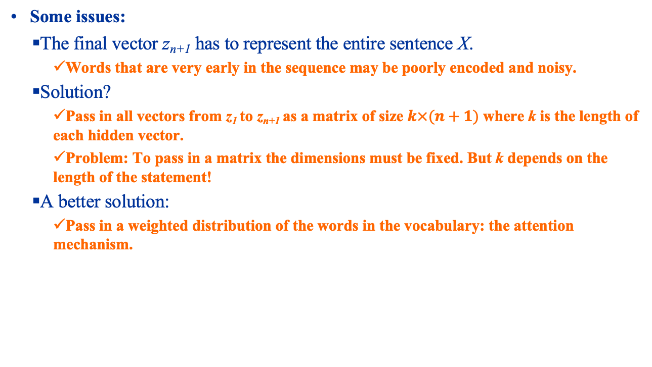
Transformers - Introduction
Some issues:
The final vector z_{n+1} has to represent the entire sentence X.
Words that are very early in the sequence may be poorly encoded and noisy.
Solution?
Pass in all vectors from z₁ to z_{n+1} as a matrix of size $k×(n+1)$ where k is the length of each hidden vector.
Problem: To pass in a matrix the dimensions must be fixed. But k depends on the length of the statement!
A better solution:
Pass in a weighted distribution of the words in the vocabulary: the attention mechanism.

Slide 42
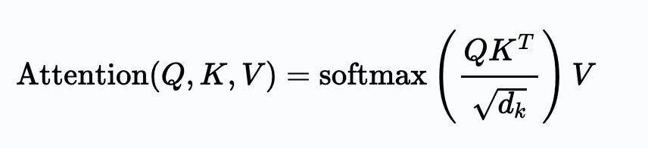
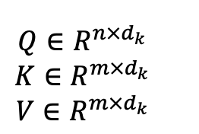
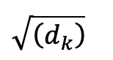
Transformers – Attention
The most common attention mechanism is the scaled dot product attention, given by:
Here Q is the query matrix, K is the key matrix, V is the value matrix, and d_{k} is the length of dimensionality of the matrices:
The Q, K and V matrices depend on what we are trying to do. In particular, when Q = K = V, we get “self attention”.
The division by mitigates the effects of large input values, which leads to smaller gradients. See link for details.

Slide 43
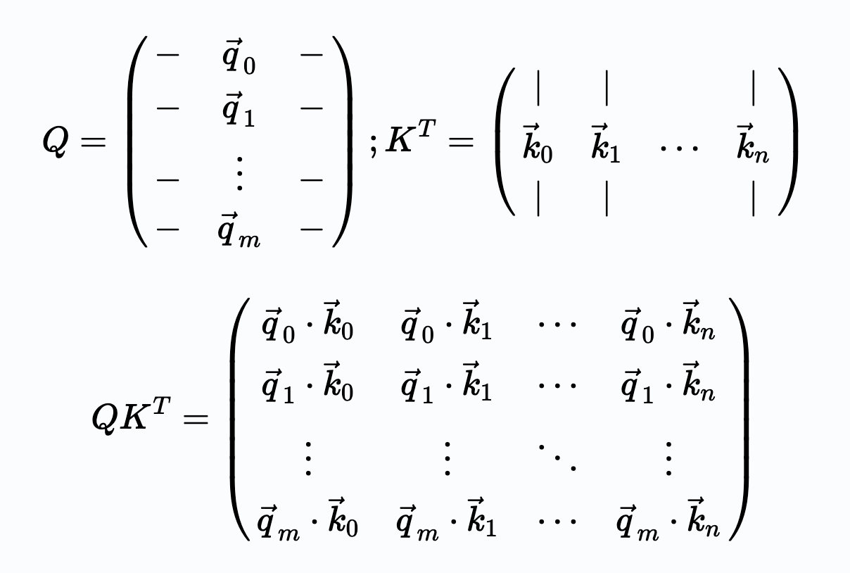
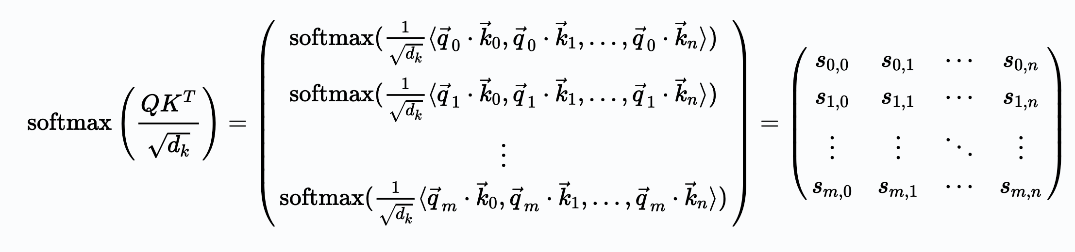
Transformers – Attention
Let’s multiply out the softmax(.) part of the equation. This gives us:
Adding in the softmax gives us:

Slide 44
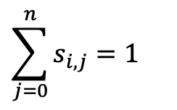
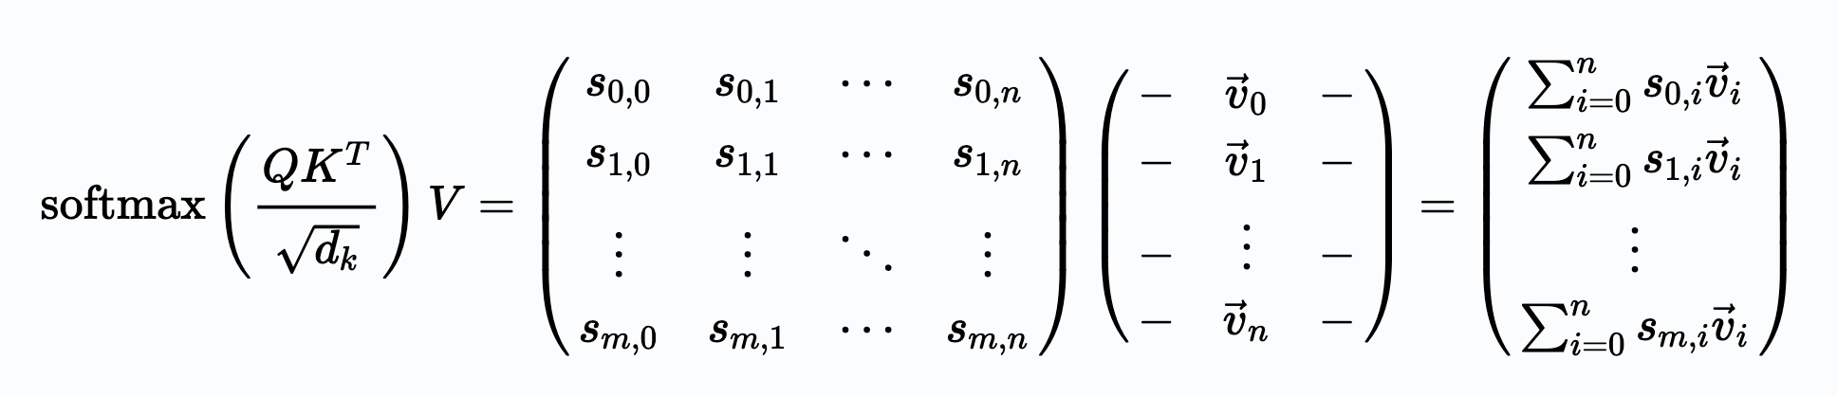
Transformers – Attention
Note that due to the softmax:
Now we multiply in V:
We can see that the end result of the attention mechanism is a weighted sum of each element of V, where the weights are determined by Q and K.

Slide 45
Transformers – Attention
Note that due to the softmax:
Now we multiply in V:

Slide 46
Transformers – Attention
We can see that the end result of the attention mechanism is a weighted sum of each element of V, where the weights are determined by Q and K.
In particular the closer some q_{i}k_{j} is, the greater the weight for v_{i}. See the link for an explanation.
The attention mechanism relates words that are within the same sentence and across sentences, resolving the issue with RNN models.

Slide 47

Transformers – The Transformer Block
A Transformer is made of Transformer blocks. Each block:
Has a multihead attention block.
An ”add and norm” block that adds the input to the Transformer Block with the output of the multihead attention block and normalizes it.
Passes this to the feedforward neural network.
Produces an output that adds that the output of the feedforward neural network to the previous ”add and norm” and normalizes it.
These blocks may be stacked multiple times in the encoder and decoder.

Slide 48
Transformers – The Transformer Block
Some details:
Multihead Attention Block:
Several linear transformations are applied to Q, K and V.
Scaled dot-product attention is then applied to each transformed version.
The results are concatenated into a single matrix.
Purpose is to discover other aspects of the inputs.
Input and positional embedding:
Input encoding converts words into vectors.
Positional encoding shows the positions of the words.

Slide 49
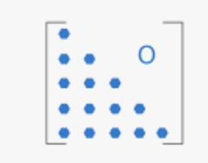
Transformers – The Transformer Block
Some details:
Masked multihead attention: Since the decoder will not in reality know the next word, when decoding future words are “masked”
Implemented as a lower triangular matrix where the lower diagon is all ‘1’ and the upper diagonal is all ‘0’.

Slide 50
Transformers
Keras does not have Transformer models per-se; you need to build them yourselves:
However it does have a multihead attention block.
Transformer code shown in transformer.ipynb.

Slide 51
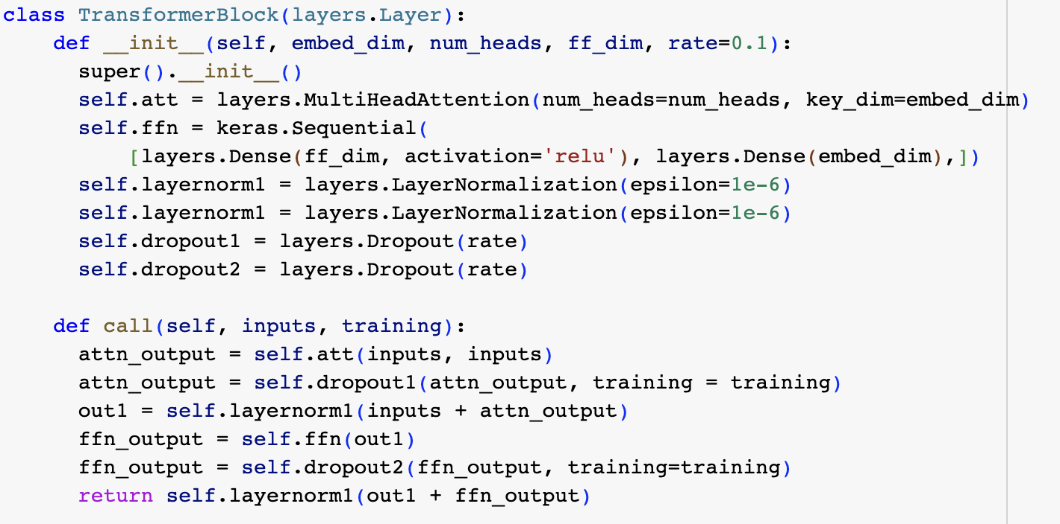
Transformers: Main Transformer Block

Slide 52
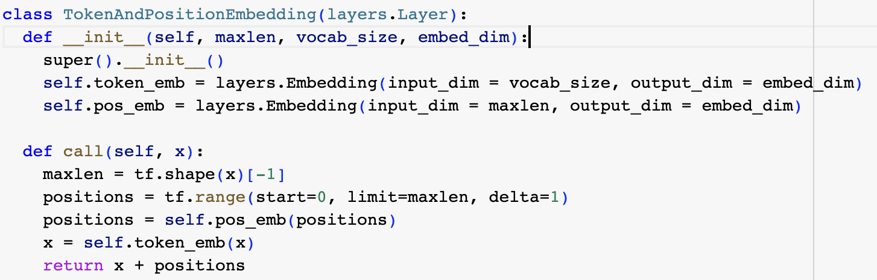
Transformers: Token and Position Embedding

Slide 53
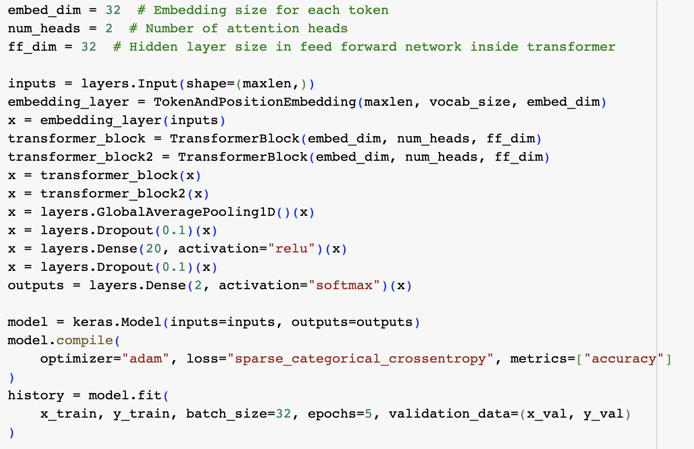
Transformers: Sentiment Analysis

Slide 54
autoencoders
SWS3009 Embedded Systems and Deep Learning.

Slide 55
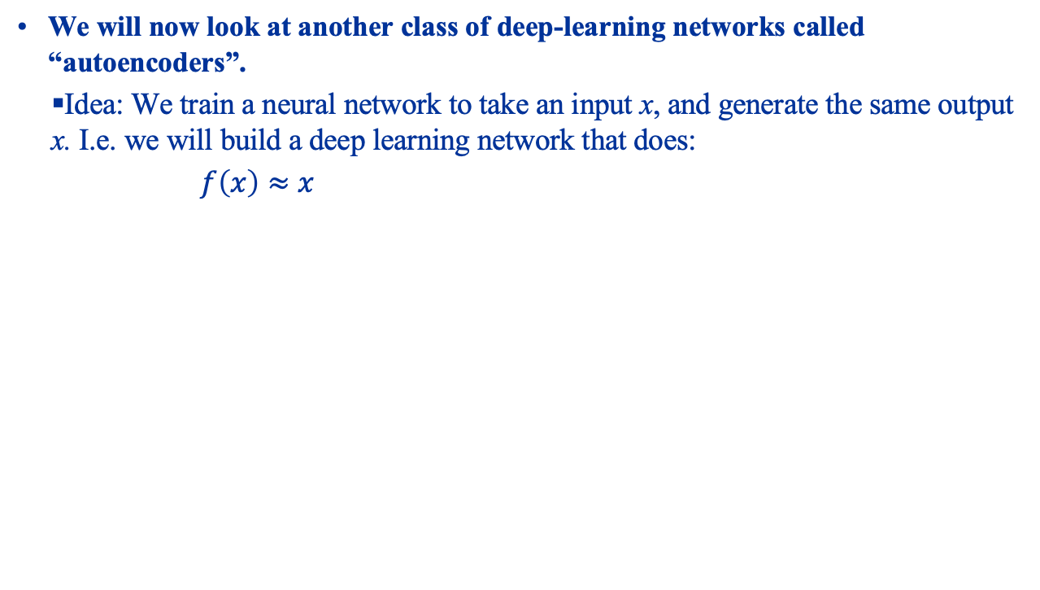
Autoencoders What Are They?
We will now look at another class of deep-learning networks called “autoencoders”.
Idea: We train a neural network to take an input x, and generate the same output x. I.e. we will build a deep learning network that does:
$f\left(x\right)≈x$

Slide 56
Autoencoders Motivation
Why would we do this? Two reasons:
We can achieve “compression”:
If the “code layer” is substantially smaller than the input, we can feed in the input and use the resultant “code” as a compressed version of the input.
We can feed this code into the decoder network to recover the original.
However AEs are very bad at this: the recovered data will be highly “lossy”, and the AE can only reconstruct data of the type it was trained on.
We can detect anomalies:
When the AE sees “typical” data it was trained on, it can reconstruct the input with minimal error.
When the data becomes atypical, reconstruction error rises. We can flag anomalies when this error exceeds a threshold.
We can remove noise from data:
The encoder learns typical data.
Noisy data is mapped to the typical data, which is then reconstructed by the decoder to clean data.

Slide 57
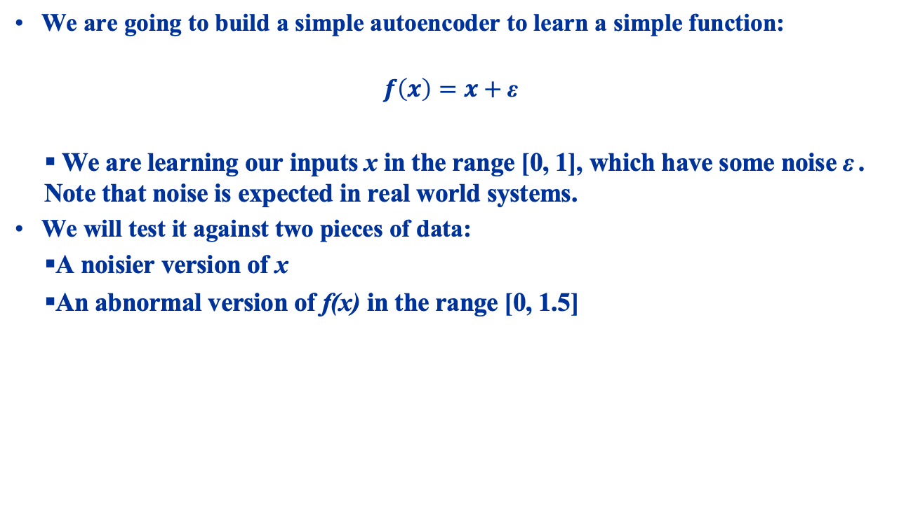
A Simple Autoencoder
We are going to build a simple autoencoder to learn a simple function:
$$f\left(x\right)=x+\text{ε}$$
We are learning our inputs x in the range [0, 1], which have some noise ε . Note that noise is expected in real world systems.
We will test it against two pieces of data:
A noisier version of x
An abnormal version of f(x) in the range [0, 1.5]

Slide 58
Autoencoder Hands On
Load up autoencoder.ipynb in Jupyter

Slide 59
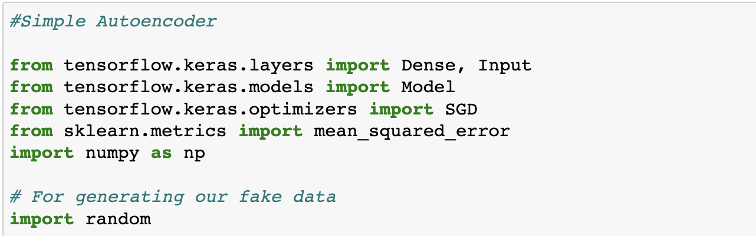
A Simple Autoencoder Imports
We begin with the imports:

Slide 60
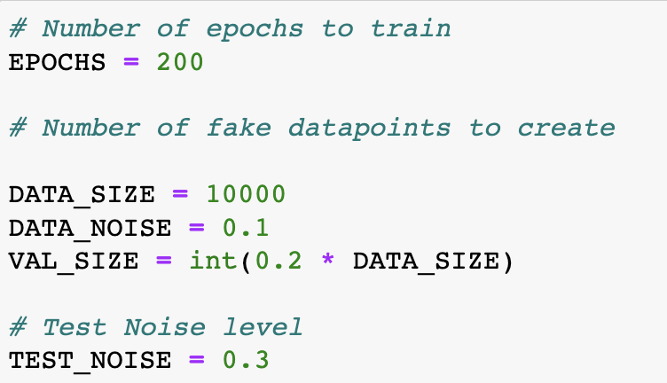
A Simple Autoencoder Training Hyperparameters
We now create some constants to configure our dummy data, AE, etc.
Here our training data will have 10,000 samples. A white noise of between -0.1 and 0.1 will be added. The data itself ranges from -1 to 1.
We add white-noise of -0.3 to 0.3 for the “noisy” version.

Slide 61

A Simple Autoencoder Building the Autoencoder
Now we can build our neural network. We will use the functional API to build a simple 6-layer MLP:
In the output we use a “tanh” activation function so that our data can range from -1 to 1.
Notice the change in name from “encoder” to ”decoder”.
This lets us build separate encoder and decoder models if we want. Useful if we want to do compression.

Slide 62

A Simple Autoencoder Generating Data
We now create our training and test data:

Slide 63

A Simple Autoencoder Generating Data
And our noisy and wrong data:

Slide 64

A Simple Autoencoder Training the Autoencoder
Now we do the training. Notice that the target (”y = …”) and input (“x = …”) are exactly the same.
This is because we are training the AE to recreate the input.

Slide 65

A Simple Autoencoder Evaluation
Finally we call the AE’s evaluate function to:
Reconstruct the given input.
Find the MSE of the reconstructed input with the actual input, and print it out.

Slide 66

A Simple Autoencoder Evaluation
We run and get the following:
We can see that the losses for the noisy version (noisy loss) and abnormal version (wrong loss) are significantly higher than the correct data (clean loss) and validation loss (test loss).
This is because the network’s internal representation is meant only for the correct data.
When presented with incorrect data it will reconstruct the input poorly.

Slide 67
Summary
In the trial lecture and this lecture we looked at neural networks and deep networks:
Neural Networks: Slow learning, potentially very powerful, can learn very complex patterns. Can be prone to overfitting due to high density of the parameters.
Deep Networks: Very large complex networks, but made up of many often heterogeneous types of networks that try to simplify the inputs, so that we can use a relatively small dense network to perform final decisions.
We saw how to learn time-series data with LSTMs and Transformers, and how to build autoencoder networks that can compress data and detect faults.
We will look at Generative Adversarsial, Convolutional and Object Neural Networks in the next lecture.

